Slide 1
Axial Sensor Evaluations
(with stators built closer to print)

Slide 2
Assembly Overview
Prototype axial URA and LRA assembled to T1xx shaft
T1xx FR4 PHA used for torque sensing
Axial LRA shimmed to center PHA in stator gap
URA to LRA gap ≈ 0.5mm
LRA stators were of better build quality than previous batch – much closer to print
Comparison between 3 parts:
Axial sensor design with new “good” stators
Axial sensor design with old “bad” stators
Current Production radial sensor design

Slide 3
Conclusions
Axial sensors seem to have comparable or possibly better gain than the current radial sensor.
Axial sensors have worse linearity than the current radial sensor.
The axial LRA with “good” stators has a lot less 1/rev than the last ones tested, and also appear to have less gap variation based on the gain results.
The 1/rev and 7/rev are worse on the axial sensor than the radial sensor’s 1/rev and 6/rev (7/rev possibly due to probe location in the gap, 1/rev possibly due to parallelism between URA and LRA surfaces).
Degaussing the axial LRA with “good” stators appears to improve the 1/rev and 7/rev content.

Slide 4
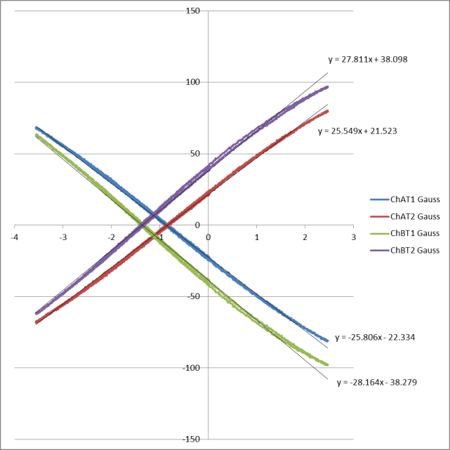
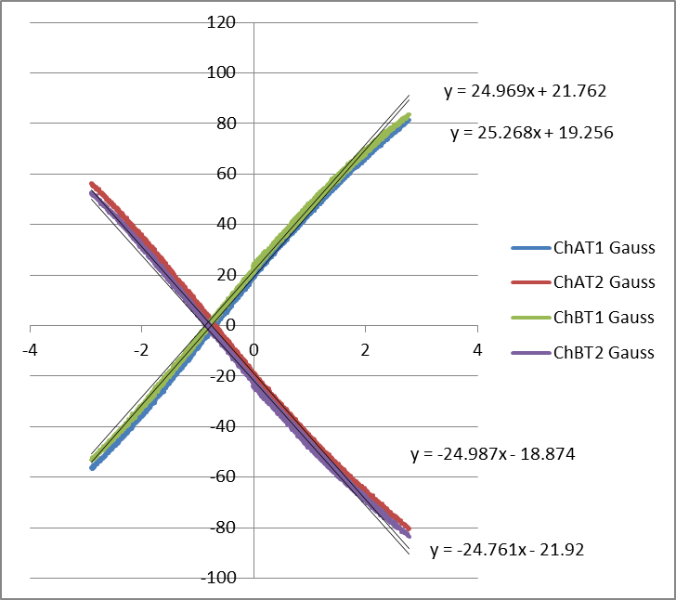
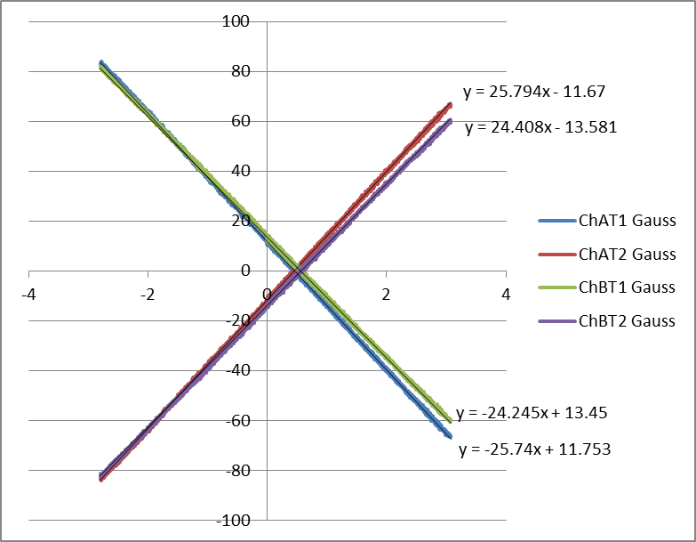
Gain Test
Sensor gain was measured by applying torque to the 3 systems. Graphs and numeric results below.
Difference between “bad” and “good” stators might be due to different stator gap (“bad” stator gap is a little tighter?)
Axial w/ “bad” stators
Average Gain = 26.83 G/°
Axial w/ “good” stators
Average Gain = 24.99 G/°
Radial Sensor
Average Gain = 25.05 G/°

Slide 5
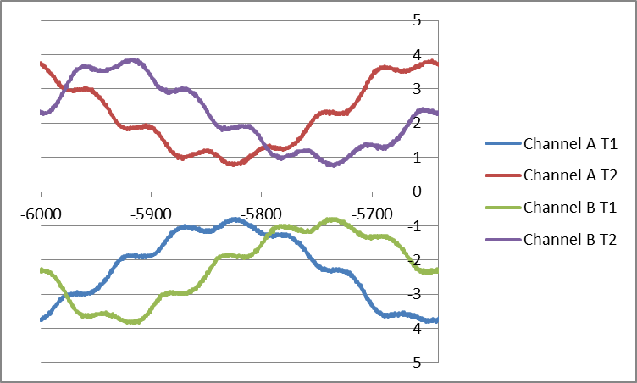
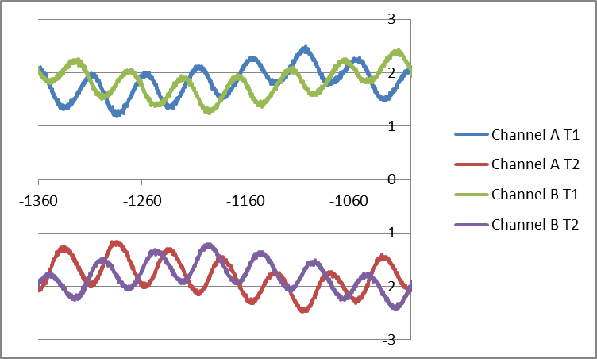
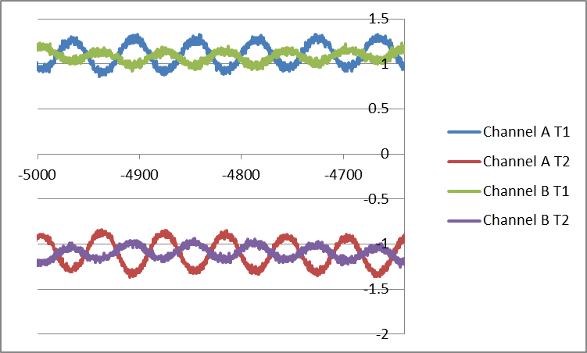
Rotational Test
Harmonics were measured while rotating the sensor components. Below are graphs and results from the 3 tests
(vertical units – uncalibrated sensor Nm, horizontal units – encoder degrees)
The axial part with better quality stators had much lower 1/rev – but still larger harmonics than the radial part
Axial w/ “Bad” stators
1/rev pk-pk ≈ 30 Gauss
7/rev pk-pk ≈ 4 Gauss
Axial w/ “Good” stators
1/rev pk-pk ≈ 5.5 Gauss
7/rev pk-pk ≈ 6.8 Gauss
Radial Sensor
1/rev pk-pk ≈ 0.4 Gauss
6/rev pk-pk ≈ 2.5 Gauss

Slide 6
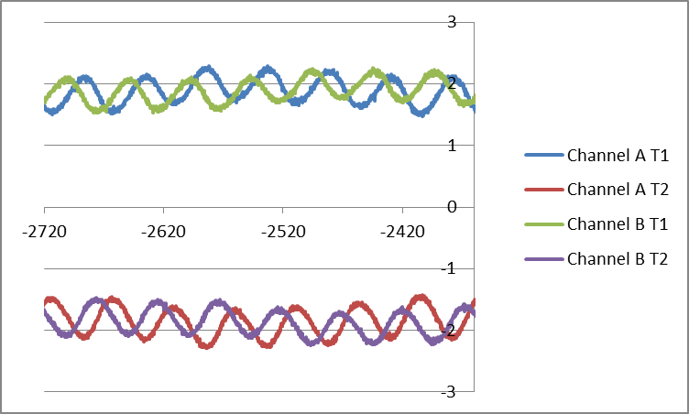
Rotational Test - Degaussing
Harmonics were measured on the “good” stator part before and after degaussing
It appears that degaussing does provide a small improvement to the 1/rev, and even the 7/rev
Before Degaussing
1/rev pk-pk ≈ 5.5 Gauss
7/rev pk-pk ≈ 6.8 Gauss
After Degaussing
1/rev pk-pk ≈ 2.1 Gauss
7/rev pk-pk ≈ 6 Gauss

